Slide 1
Human Wildlife Interaction Sentiment Analysis on Twitter

Slide 2


Who we are
Isaac Lo
iclo@dons.usfca.edu
Chandan Nayak
cnayak@dons.usfca.edu

Slide 3
Need for Study
Large information gap in human-wildlife conflict reports.
CDFW only receives a few thousand reports a year in a state of 40 million people.
CDFW only receives reports of “problems.” Reports of positive encounters are not received

Slide 4
Our Project:
What is the sentiment on tweets relating to human and wildlife interactions?

Slide 5


Accessing Twitter Data
Tweepy
Twitter API
Data Preparation
Text Classification
Sentiment Analysis

Slide 6
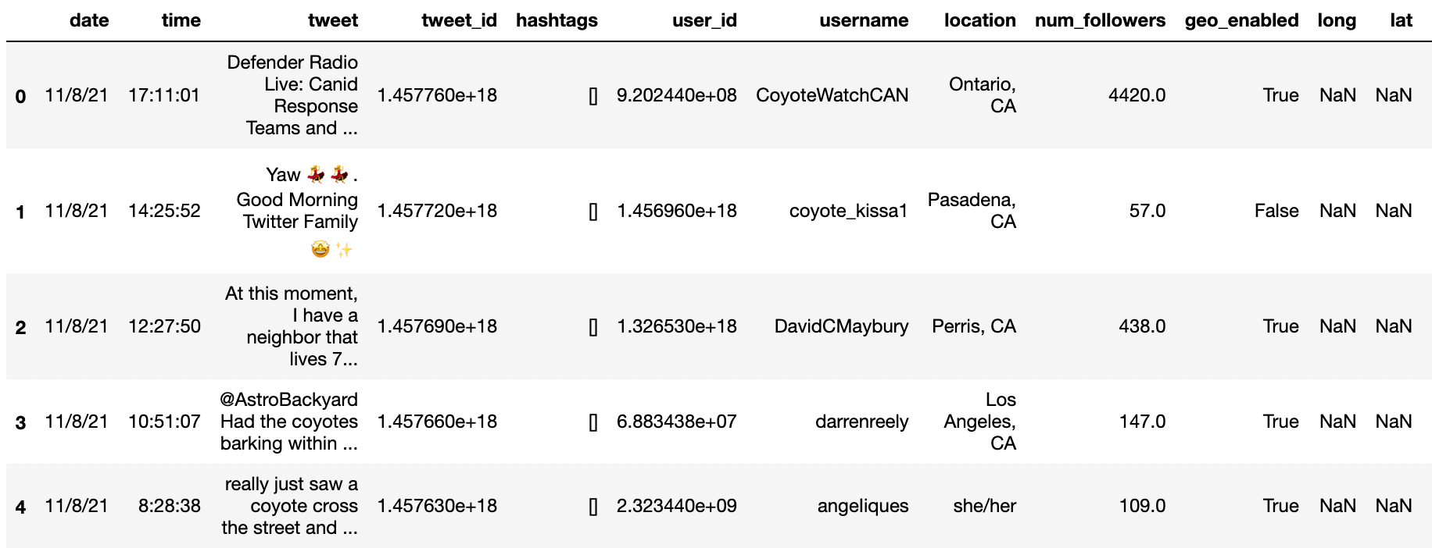
Information Pulled From Tweets

Slide 7
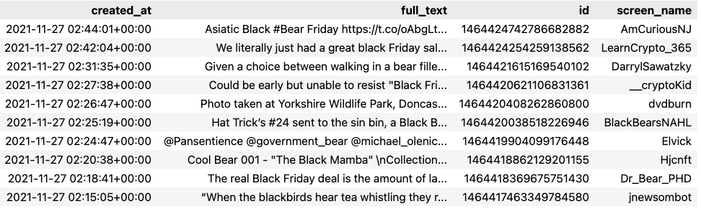
Information Pulled From Tweets - Black Bears
Query used: “‘black bear’ -filter:retweets” and “‘black bear’ AND tahoe -filter:retweets”

Slide 8
Coyotes Tweets

Slide 9
Initial Queries
Broad queries
query = “coyotes OR coyote”
Omitted retweets
Targeted Geographical Hotspot Locations
LA, SD, SF
50 mile radius

Slide 10
Initial Query: Results
A lot of irrelevant and ambiguous tweets
“Hey Coyotes! Next week we do not have school on Thursday, November 11th. Please plan accordingly.”
“Coyote revolution has begun btw”
Some relevant tweets
“Saw a group of about five coyotes today walking down the street, definitely hanging out.”
“There was a coyote in my backyard this morning. Why?”

Slide 11
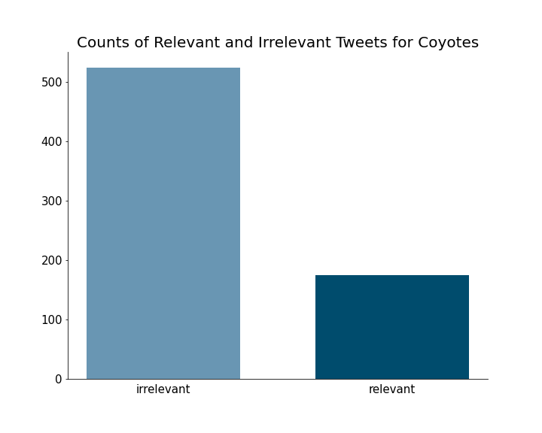
Initial Query

Slide 12
How to Get Relevant Tweets?
Text classification using machine learning
Optimize query to omitted tweets containing specific words

Slide 13
Tweet Classification
Goal: Classify tweets related to human and wildlife interaction
Steps:
Manually tag tweets
Convert tweets to vectors for modeling
Create different models
Naive Bayes
Support Vector Machine
Compare models and select best one

Slide 14
Tweet Classification: Model Selection
Candidate Model 1: Naive Bayes Classifier
Validation accuracy: 92%
Validation f1-score: 82%
Candidate Model 2: Support Vector Machine
Validation accuracy: 87%
Validation f1-score: 72%
Final Model: Naive Bayes Classifier
Test accuracy: 91%
Test f1-score : 81%

Slide 15
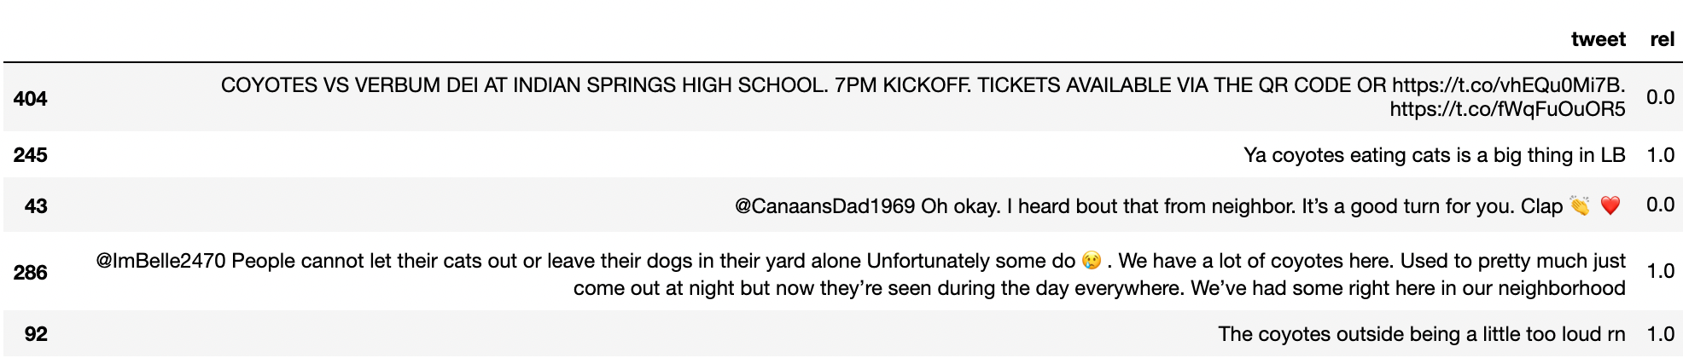
Tweet Classification: Example

Slide 16
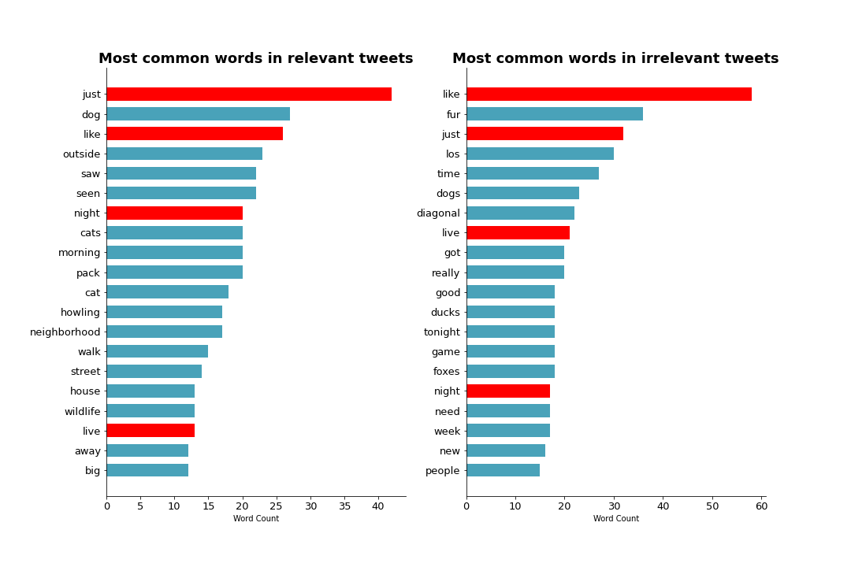
Optimizing Query
Initial Query:
query = 'coyote OR coyotes' -is:retweet -is:reply'
Choosing disqualification words
Intuition
Most common words in irrelevant tweets

Slide 17
Optimizing Query: Disqualification Words
irrelevant_words = ['ugly', 'drugs', 'movie', 'team', 'halloween', 'season', 'hawks',
'predictions', 'sports', 'restaurant', 'soccer', 'basketball', 'tennis', 'ball',
'indian', 'ducks', 'game', 'school', 'arizona', 'nhl', 'win']

Slide 18
Sentiment Analysis: vaderSentiment
What is vaderSentiment?
Sentiment analysis tool designed for social media text
Why vaderSentiment?
Pretrained on social media text
Takes into account:
Emojis: 😁 ❤️ 🐶
Acronyms: lol, ty, gn
Emoticons: :) :D :(
And more

Slide 19
Sentiment Analysis: Metrics
Positive Score: Ratio of words that are classified as positive
Neutral Score: Ratio of words that are classified as neutral
Negative Score: Ratio of words that are classified as negative
Compound Score: Sum of valence score of each word in tweet.
Normalized to be between -1 (most extreme negative) and +1 (most extreme positive)
Sentiment Classification
Positive: compound score ≥ 0.05
Neutral: -0.05 < compound score < 0.05
Negative: compound score ≤ -0.05

Slide 20
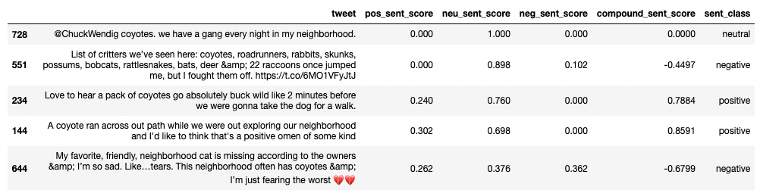
Sentiment Analysis: Example

Slide 21
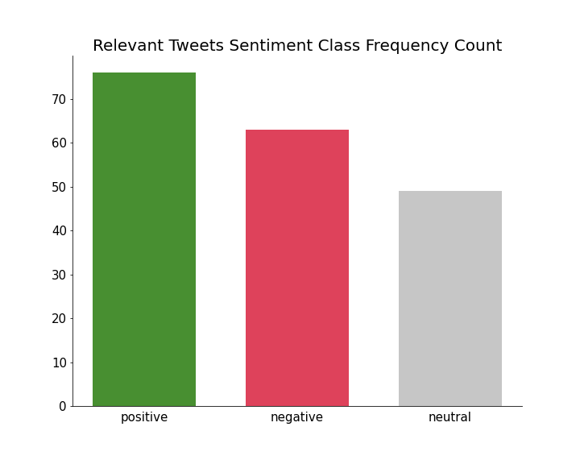
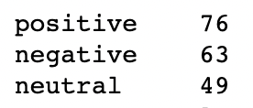
Sentiment Analysis: Sentiment Class

Slide 22

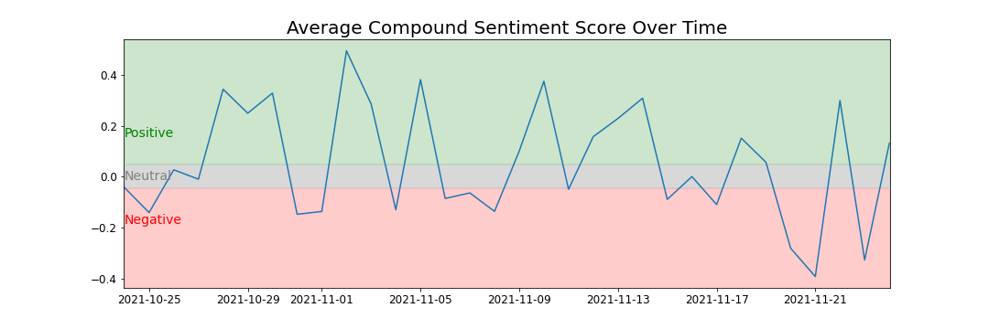
Sentiment Analysis: Compound Score

Slide 23
Bear Tweets

Slide 24
Predicting relevant tweets using ML
Baseline prediction model: Naive Bayes
Trained on 400 labelled tweets
Using a Train-Test split of 40%, an accuracy score of 65% was achieved
Improving accuracy:
Adding more labelled examples
Getting more representative sample of tweets - temporally

Slide 25
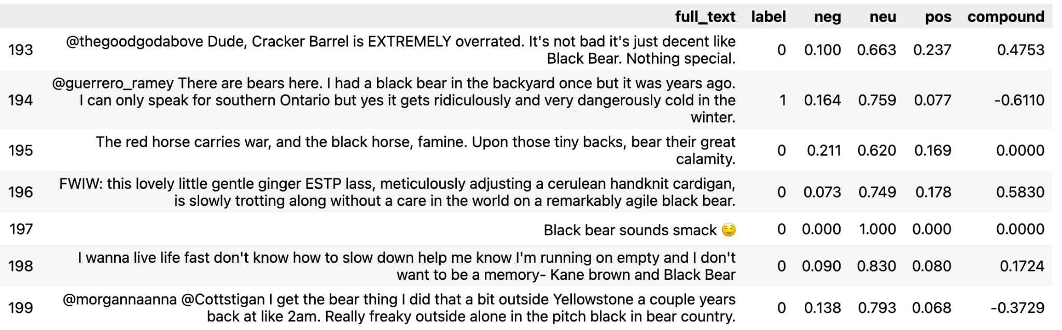
Sentiment Analysis
Baseline prediction model: Naive Bayes

Slide 26
Challenges

Slide 27
Challenges - Supervised learning
Machine learning models require labelled training data. Ideally higher number of trained data leads to better performance metrics
Manual labelling of relevant tweets - even presence of keywords in right order doesn't necessarily mean the tweet is relevant
More common to get irrelevant tweets - sports teams, diner chains, shopping events etc.

Slide 28
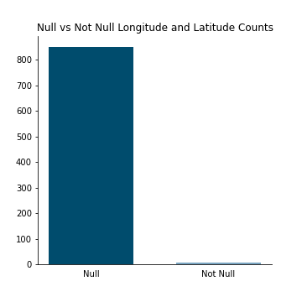
Challenges: Twitter Data
Not all tweets have geographical location
Missing tweets by specifying search location
Most tweets don’t have exact coordinates
Only analyzing a general area
Not enough data
Classification models may not be as reliable
850 Missing Coords
5 Has Coords

Slide 29
Challenges: Twitter API limitations
Using free tier of developer API
Twitter restricts history to past seven days
Most analysis done with tweets from November period
Ideally, we want to build a corpus of tweets from the entire year - periods in which animals are active

Slide 30
Challenges: Collaboration
Approached coyotes and bears independently
Pulled different data
Different modeling techniques
Did not progress towards project goal uniformly

Slide 31
Next Steps

Slide 32
Next Steps
Target More Specific Locations:
More precise coordinates and smaller search radius
Bounding box: Search a geo polygon specified by 4 coordinates
Stream tweets:
Create pipeline to retrieve relevant tweets in real time
Can use to train a better classification model
Real time sentiment analysis

Slide 33
Next Steps: Continued
Continue Observing General Trend of Sentiment:
Watch for anomalies in trend

Slide 34
Next Steps: Continued
Standardize Approaches and Improve Collaboration:
Pull same variables from twitter
Create infrastructure for pipeline
Create multiclass tweet classifier
Add more labelled examples
Keep on adding to corpus of labelled tweets to improve classifier accuracy

Slide 35
Github
https://github.com/Isaac1o/CDFW

Slide 36
Questions?

